Slide 1
Welcome Huskies to the 2021-2022 School Year!
Ms. Regina Mann, M.A.
rmann@washoeschools.net

Slide 2
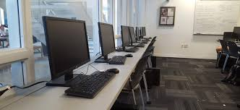
Agenda: Health/Hygiene Resources Computer Lab Expectations Teams Syllabus

Slide 3
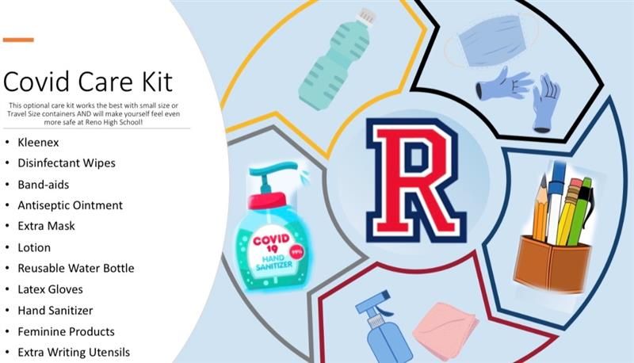
3

Slide 4
Where to go for resources:
Reno High Website:
https://www.washoeschools.net/renohs
Edgenuity:
https://auth.edgenuity.com/login/saml/student/washoeschools
User: *studentid@washoeschools.org
Pass: same log in for Teams
(*use your own id number)
Ms. Mann’s email:
rmann@washoeschools.net
Reno High Website has many links and recourses including email addresses for administration, counselors, and teachers.
Edgenuity is a self-paced credit recovery/credit accrual on-line program. There are also supplemental lessons you might be assigned from other teachers.
You or your parents/guardians can email me with questions, comments, concerns as I check emails regularly!
4

Slide 5
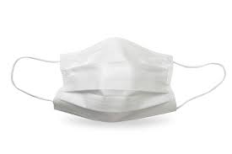
Computer Lab Expectations:
No mask, no entry
Sanitize hands and clean work area every day
NO FOOD allowed in the lab this year (including snacks during class and lunch)
Water only (With Lid )
Come to class prepared ready to learn/work
Headphones
Composition book
Pencils/pens
Highlighter
5

Slide 6
Computer Lab: What does it look, sound, feel like?
LOOK:
Your eyes should be on your computer
You should be interacting with your course in Edgenuity
You should be taking notes on what you don’t know including the academic vocabulary, main ideas, people, formulas, etc.
SOUND:
It sounds quiet in the lab with everyone working with intent to complete lessons.
FEEL:
It feels purposeful
If feels intentional
If feels productive
If feels that you are showing honor to those learning including yourself.
6

Slide 7
Microsoft Teams
All students have access to Microsoft Teams. This will be your hub of resources for this class as well as your other classes at Reno High School.
Attendance, assignments, syllabus, resources, etc.
The log in for Teams is the same as your District log in when you are on the computer at school. There is a link from the RHS webpage if you can’t remember your log in…check out the QR code!

Slide 8
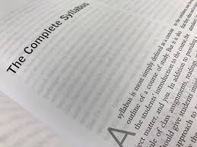
Credit Accrual/Credit Recovery ~ Edgenuity
2021-2022 Syllabus
Ms. Mann ~ Reno High School
E-mail: rmann@washoeschools.net
Introduction
Welcome to Edgenuity Credit Accrual/Credit Recovery. This is an opportunity to earn credit in an on-line platform through Edgenuity. Students can access their course anywhere there is access to the Internet. This is a self-paced, self-motivated class, based of the recommendation of your counselor, with curriculum following Washoe County School District standards. Please see “Edgenuity Student Experience” YouTube video for more information: https://www.youtube.com/watch?v=8YcrkabG4uU.
Class Materials Needed
Composition book for a working journal for notes. Taking notes are essential to pass the unit exams and final exam. (See additional information regarding grades on the Edgenuity Student Orientation Form.)
Ear buds/headphones (we have a set at every computer, but you are welcome and encouraged to use your own since cleaning of the headsets will be challenging.)
Of course, with Covid-19, the use of class materials will be limited so bring pencils, pens, highlighters. There are some in the classroom but with limited quantity.
Please see the “Covid Care Kit” in Teams. for recommended supplies to bring with you to campus daily.
The Syllabus can be found in Teams...

Slide 9
Assignments/Grading
Grades are based on their academic performance in Edgenuity. You will need to finish and pass the class and final to earn the 0.5 credit for each course. Successful students will attend regularly, come to class on time, participate in class, and do all assigned work. ACADEMIC INTEGRITY IS ESSENTIAL TO ON-LINE COURSES, please do your own work.
Attendance/Tardies
Success in any class depends upon regular attendance and participation. You are urged to make every effort to be in class every day. We follow the Washoe County District attendance policy.
Classroom Behavior/Expectations
It is expected that you will behave as young adults with the understanding of what is appropriate behavior in society as well as in the classroom. Most issues will be handled for the most part through the teacher and student. Students are expected to follow the school-wide rules established on dress code, behavior, tardy policy, and passes. See RHS student planners for the appropriate attire and behavior. Come to class prepared and willing to learn with required materials every day. NO FOOD ALLOWED IN THE COMPUTER LAB.
The Syllabus can be found in Teams...

Slide 10
Assignments/Grading
Grades are based on their academic performance in Edgenuity
You will need to finish and pass the class and final to earn the 0.5 credit for each course
Successful students will attend regularly, come to class on time, participate in class, and do all assigned work
ACADEMIC INTEGRITY IS ESSENTIAL TO ON-LINE COURSES, please do your own work

Slide 11
Other resources (found in Teams)
Tips for Student Success
Metacognitive Markers
Student Guide to On-Line Learning
Edgenuity Student Orientation Form
What can I work on in the Computer Lab?
Edgenuity Start Guide (same information as on the YouTube video in print form)
11

Slide 12
12

Slide 13
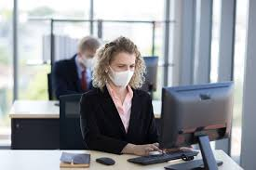
What can I work on while in the computer lab?

Slide 14
ANY QUESTIONS? THANK YOU!
Name: Ms. Regina Mann, M.A.
Phone: 775-333-5050 ext. 34169
Email: rmann@washoeschools.net
Website: washoeschools.net/renohs

